Slide 1
This is an impact evaluation study. We may want to see the effect of the mailing strategy over consistenly inactive users
To tackle the problem, we may want to consider the following steps: 1. Mailing was sent out on 201903 week, so dataset will be split into before 201903 and after 201903 inclusive. That determines a pre and post scenario.
2. Our N is going to consider till 4 different scenarios (and datasets as an extension). Following, a scheme depicting the four groups:
3. The design considers:
Pre control group of consistently inactive users that havent received any mailing (receiviningmaililing =0)
Post control group of consistenly inactive users that havent received any mailing (receiviningmailing = 0)
Pre experimental group (201903 <) of consistenly inactive users that haven’t received mailing(yet)
Post experimental group(201903 =>) of consistenly inactive users that have received mailing.

Slide 2
The condition to be control or experimental is based on:
They are consistently inactive users or not (1 out of 4 categories of regularity activity feature).
They received the mailing (1) or dont (0).
Whether a consistenly inactive user belong to a pre or post scenario is based on weeknum column: 201903 < Pre intervention, whereas 201903 >= Post intervention.
We may want to know whether the effect of mailing has an impact in the consistenly inactive users. For that we hyphotetize:
Whether the proportions of consistently inactive users are the same or not before and after the first week of implementation of the mailing (201903).
Whether the proportions of consistently inactive users are the same or not before and after the mailing was sent (in the experimental groups.
Whether the proportions of consistently inactive users are the same or not before and after the mailing was sent (in the control group, that is the ones that haven’t received any mailing).

Slide 3
RQ1: Has the mailing been successful in reactivating consistently inactive users?
RESULTS BEFORE AND AFTER RECEIVING THE MAILING

Slide 4
Control
We may want to see if there are differences in terms of proportions of consistently inactive users before and after weeknum 201903. Even though this is control group, which means that they havent received mailing, its worth to determine if groups change their status before and after 201903 week.
For doing so, we ran a Prop Z Test, so we can determine if groups are significally different or not in pre and post control scenarios.
The p-value is .41 which is more than the significance level of 0.05. We can conclude that the proportion of
Consistenly inactive users is not significally different on a pre mailing and post mailing situation in the control group.

Slide 5
Experimental
We may want to see if there are differences in terms of proportions of consistently inactive users before and after weeknum 201903. This is the experimental group which means that they have received mailing (input) that may explain a change in their behaviour after receiving mailing.
For doing so, we ran a Prop Z Test, so we can determine if groups are different or not in pre and post experimental scenarios.
The p-value is 5.192 e-12 which is less than the significance level of 0.05. We can conclude that the proportions of
Consistenly inactive users are different in the experimental setting.

Slide 6
Control vs. Experimental

Slide 7
RESULTS FOR THE WEEK 201903 SOLELY (WEEK OF RECEIVING THE MAILING)

Slide 8
201903 Week - Control vs. Experimental
By comparing just the week 201903 in a group that hasn’t received any mailing and the group that
received mailing in the 201903 week, we see that there is a different in terms of consistently inactive
users. For knowing so, we ran a Prop Z Test, so we can determine if groups are different or not.
The p-value is 9.595 e-7 which is less than the significance level of 0.05. We can conclude that the proportions of consistenly inactive users are significally different in these two groups.
Only 2% of variance

Slide 9
RQ2: If reactivating consistently inactive users, how long has this impact been sustained (i.e. how many weeks)?

Slide 10
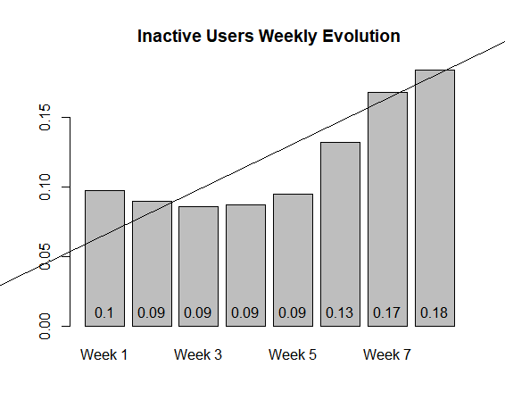
In order to respond 2nd question the graph below tries to depicts what happened with the mailing input.
First off, week1 corresponds to the 1st week of receiving mailing, so its 201903. Week 2, Week 3 and so forth
correspond to 201904, 201905 and so on.
Second, I may want to stress out that one marketing activity shouldnt has been thought
as a solely single action that is going to has a lasting impact on a specific target.
Even though we have noticed that, indeed, the numbers of inactive users dropped due to the mailing effect, this ouput only lasts one week and then the number of inactive users goes up for the upcoming weeks. This can be seen in the graph below

Slide 11
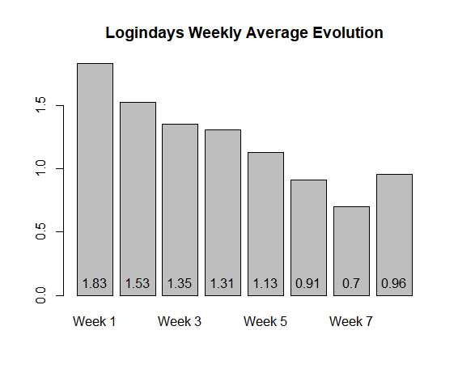
Worth to notice that the average (mean) logindays starts to decrease as long as we move onto upcoming weeks; around Week 5, the average login days started to decline, which contributes to the argument that the intervention effect last for 5 to 6 weeks

Slide 12
Other variables to be considered
I may want to know if weeksinceregistration is related to not being consistenly inactive or not. I.e people that have been registered 300 weeks ago, they may be more active (or not). Same goes for educational label.
So it may worth it to test whether inactive users are changing to being more active given that they have been registered for 300 weeks ago or not.

